Slide 1
WELCOME
www.orbitzfin.com

Slide 2
INTRODUCTION TO ORBITZ
ORBITZ is a diversified Integrated Business service provider offering a multitude of financial business services options.
The diverse bouquet of Financial services which Orbitz offers can be broadly allied across key verticals:
Retail,
Corporate,
Institutional and
Wealth spectrums.
The services extend from
Insurance,
Retail Banking, Finance,
Mutual Funds,
Realty,
Legal Advisory,
Tax Consulting and
Corporate Business Advisory etc.
www.orbitzfin.com

Slide 3
INTRODUCTION TO ORBITZ
Orbitz company - for all its business structured and being operated through various subsidiaries (Referral Business Consultants).
Orbitz was established in 2009 for and providing financial and professional consultancy services to Business Houses, High Net Worth Individuals, Firms, Private Limited and Limited Concerns all over India and performing operations well in multiple states mainly Andhra Pradesh, Telangana, Odisha, Tamilnadu , Karnataka, Kerala, Maharashtra and Gujarat.
www.orbitzfin.com

Slide 4
OUR VISION & MISSION
Our Mission
Providing complete financial solutions and services to the customer with care driven by the core values of diligence and transparency..
Our Vision
To build Orbitz as a professionally trusted brand in the Integrated Business domain across India.
To develop and market the financial services to customers with complete range of products.
Brand Essence
Core brand essence is Diligence and Orbitz is driven by Ethical and dynamic processes for wealth creation, document processing products, services and solutions so as to help our customers become more productive.
www.orbitzfin.com

Slide 5
MAIN KEY VERTICALS IN ORBITZ
Digital Payment:
Retail Banking:
Finance:
Insurance:
Real Estate:
www.orbitzfin.com

Slide 6
DIGITAL PAYMENT
Orbitzpay NOW ventured into AEPS -Aadhar Enabled Payment Services and is the Partner of “Mahagram Payments Pvt Ltd (DBA Mahagram) which has an arrangement with ICICI Bank Ltd / Airtel Payments Bank Ltd as Business Correspondent - Corporate,” providing service Of MATM and AEPS.
Our AGENTS can carry out the Digital Payment business on behalf of
ICICI BANK for:
AEPS Cash withdrawals,
Money Transfer,
Fund Transfer,
BBPS Services like All Mobile Recharges,
DTH Recharges,
GAS/Telephone Bill Payments,
Electricity Bill Payments Etc.,
In every Village/Mandal/Semi Urban and Urban areas.
www.orbitzfin.com

Slide 7
BRANDS WE DEAL WITH
BRANDS NOW ASSOCIATED WITH
www.orbitzfin.com

Slide 8
Why Digital Payment is Required?
Reason: Banking Problems
Distance – To Banks OR ATMs
Rigid timing (Particular Banking Hours)
Non availability of CASH in ATMs
Over crowding – Queue up in long lines
Illiteracy – Filling Chillan.s/withdrawal Forms
Low penetration of net banking in Rural / semi-urban areas
Digital Payments available on Bank Holidays & on 24x7 availability
www.orbitzfin.com

Slide 9
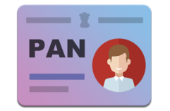
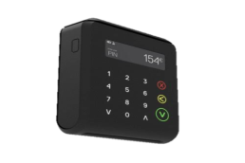
SERVICES OFFERED
Financial Inclusion
Make PAN Card for all (Individual, Company, NGO etc)
eGovernance
AePS
BBPS
Domestic Money Transfer
Recharge & DTH
MicroATM
Major Advantage:
Agents can do 5 txns per bank, no limit on per Aadhaar.
This will multiply agent’s business. Additional earning opportunity.
Integration is already done with almost all Biometric device.
No need to carry ATM card & no need to remember PIN number
No restriction from acquiring bank on number of transactions. (allowed unlimited transactions)
On demand / Real Time Settlement
Compliment existing business with additional footfall & save MDR
Solve Cash Management issue
AePS & Micro ATM advantages
www.orbitzfin.com

Slide 10
BENEFITS TO THE AGENT
Minimum Investment
“Big Bunch of Products & Services”
Agent can operate the app from Mobile or Laptop/Desktop.
Can make AEPS transaction – withdrawals & cash deposits from any bank accounts
for his customers.
Agent can earn on each PAN card registration.
Two/Four wheeler Insurance, insurance premium collection, Life & Health
insurance, Personal/Business/Home Loans.
CARD SWIPING FACILITY – Swiping of Debit OR Credit Card of Any Bank.
Daily 4 times settlement of transaction amount/Shortly Introducing REAL TIME
Settlements.
“Earn Commission on Every Transaction”
www.orbitzfin.com

Slide 11
DOCUMENTS REQUIRED FOR REGISTRATION OF AGENT
Clear Photos of:
PAN Card
b) Aadhaar Card
Shop photo (Optional)
Passport Size Photo
e) Mobile Number
f) E-Mail ID
Same Day Aeps ID Activation
Activated by:
By Uploading KYC on AePS txn page on Mobile App By Agent
www.orbitzfin.com

Slide 12
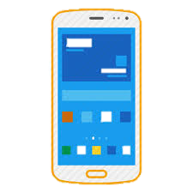
AePS NECESSARY FACILITIES
Internet
(WiFi OR
2G/3G/4G Mobile)
OR
Biometric
(Fingerprint
Device)
Computer
Desktop or Laptop
Android phone
www.orbitzfin.com

Slide 13
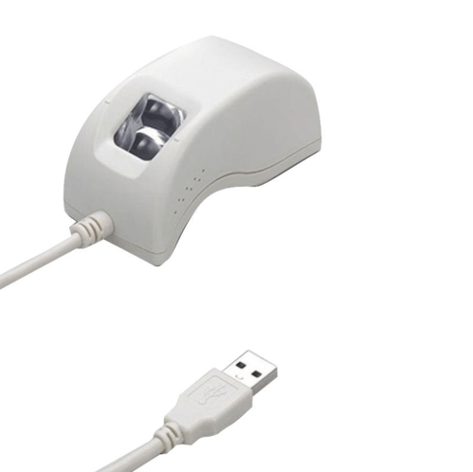
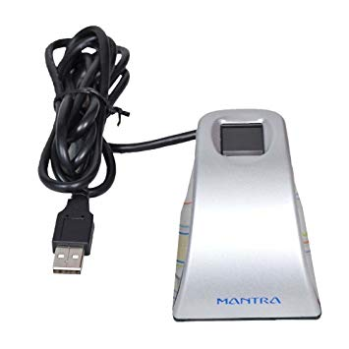
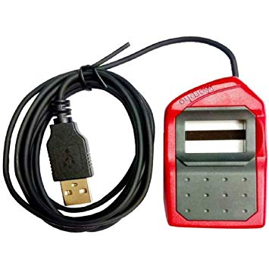
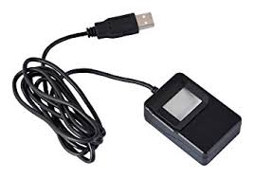
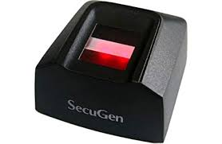
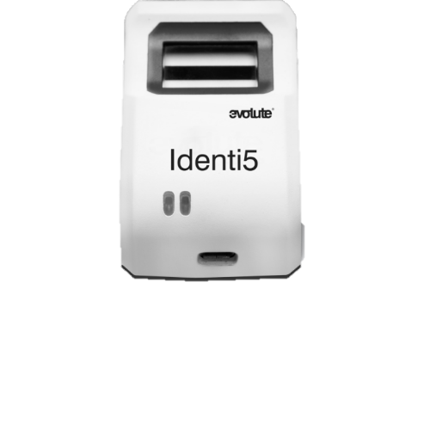
BIOMETRIC SUPPORTED
Morpho E2
Morpho E3
Startek
Mantra MFS100
Tatvik TMF20
Secugen
Evolute
www.orbitzfin.com

Slide 14
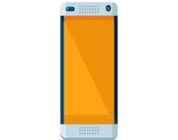
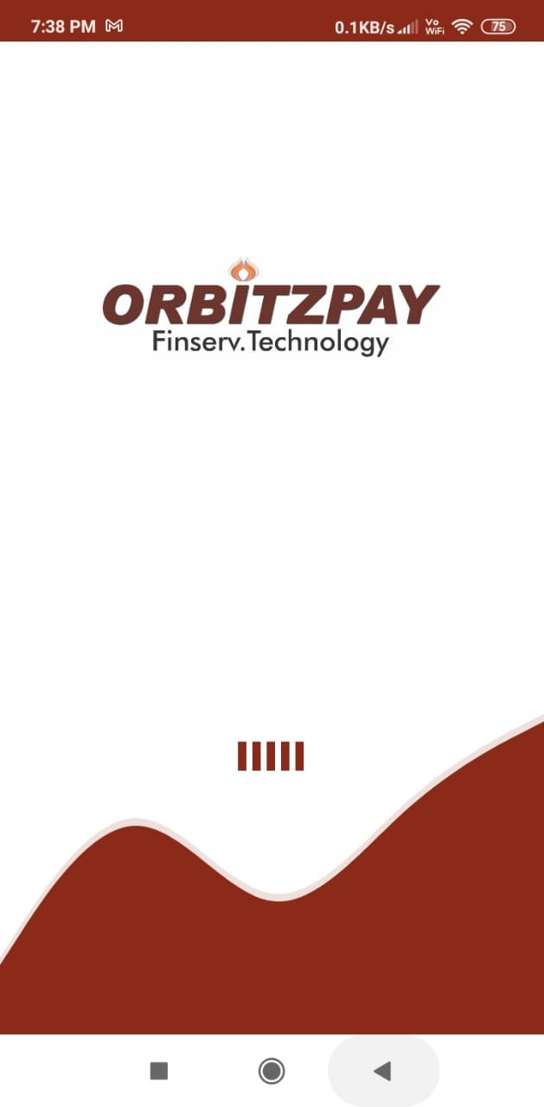
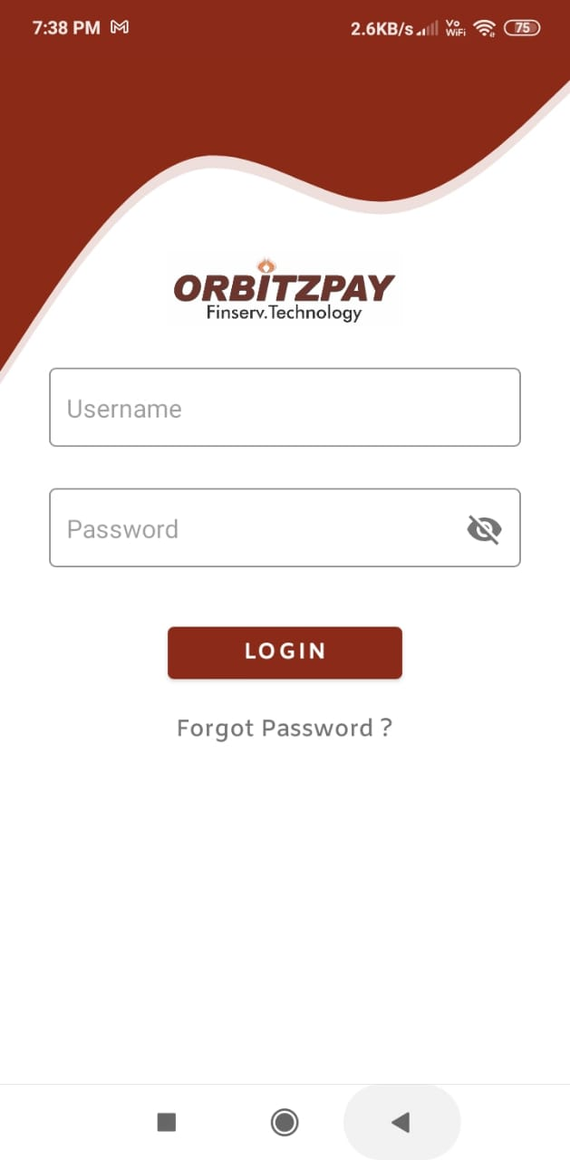
AePS ON SMARTPHONE (MOBILE)
PIC 1 : Download OrbitzPay Mobile App
PIC 2 : Open OrbitzPay Mobile App. Enter Your Mobile Number - Your User ID.
www.orbitzfin.com

Slide 15
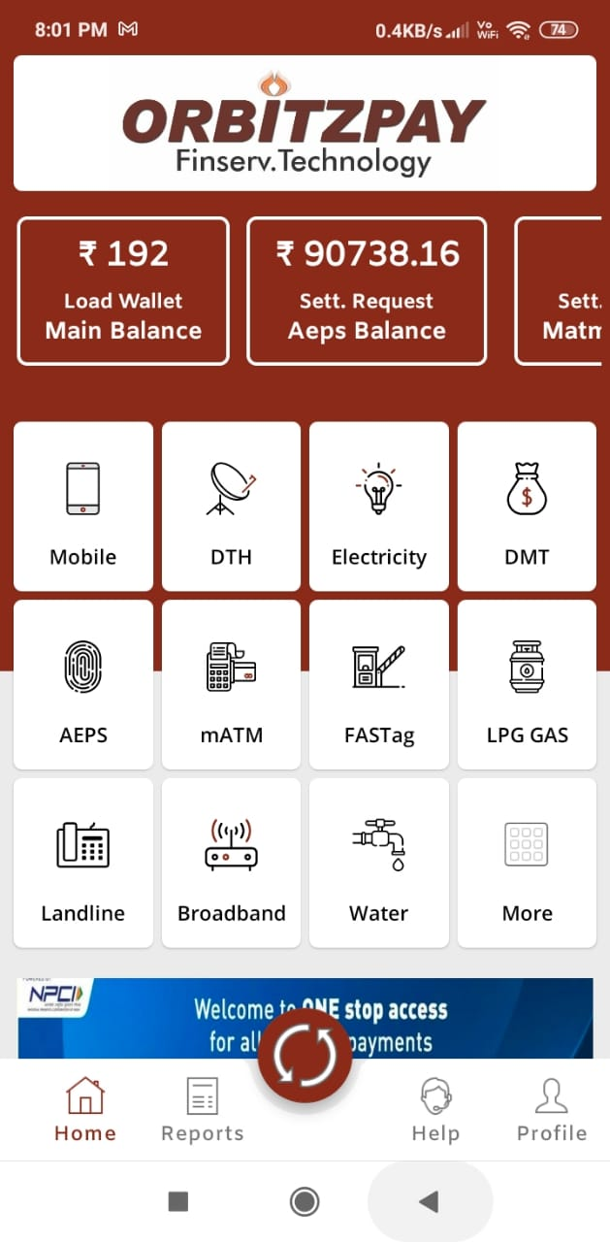
AEPS on Smartphone (Mobile)
Press FORGOT PASSWORD . It will ask to enter your E-Mail ID. You will receive a message that PASSWORD is sent to your Registered Mobile Number.
You will receive PASSWORD through SMS on your Mobile Number.
After Entering Password you can LOGIN & Login Page will appear.
www.orbitzfin.com

Slide 16
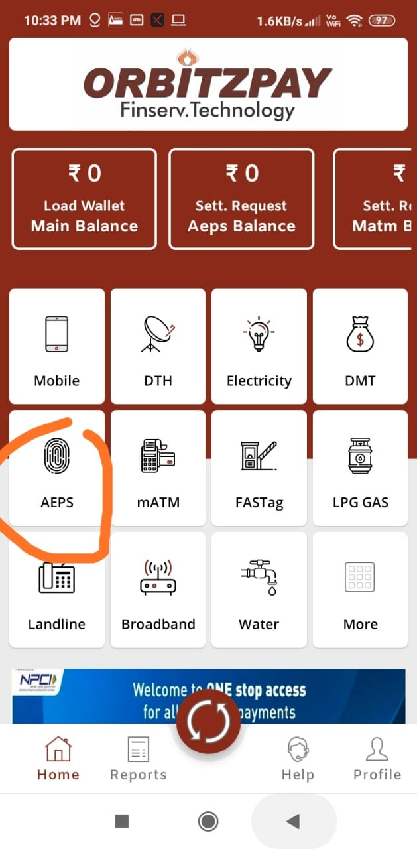
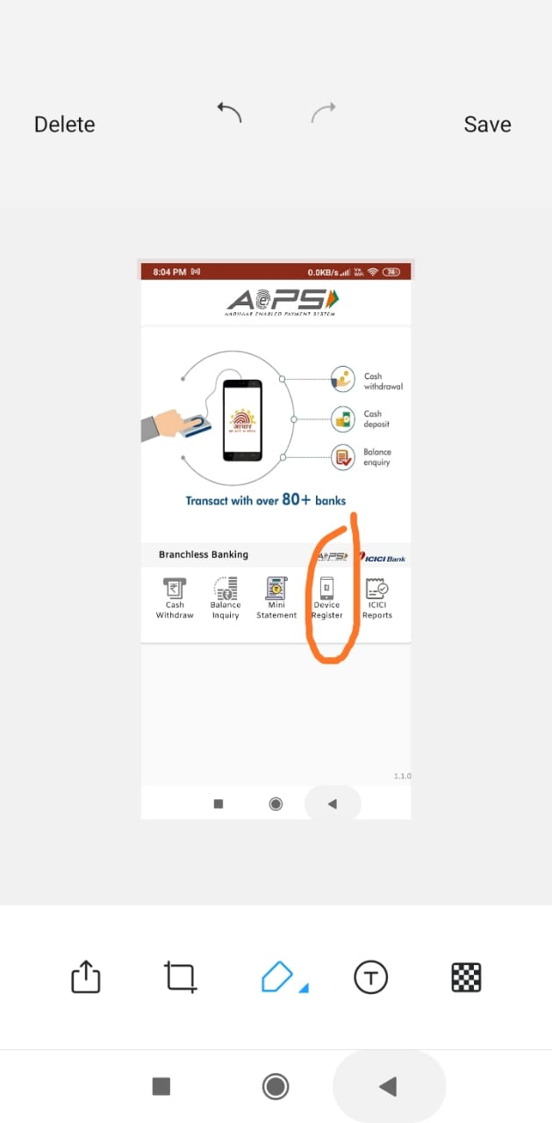
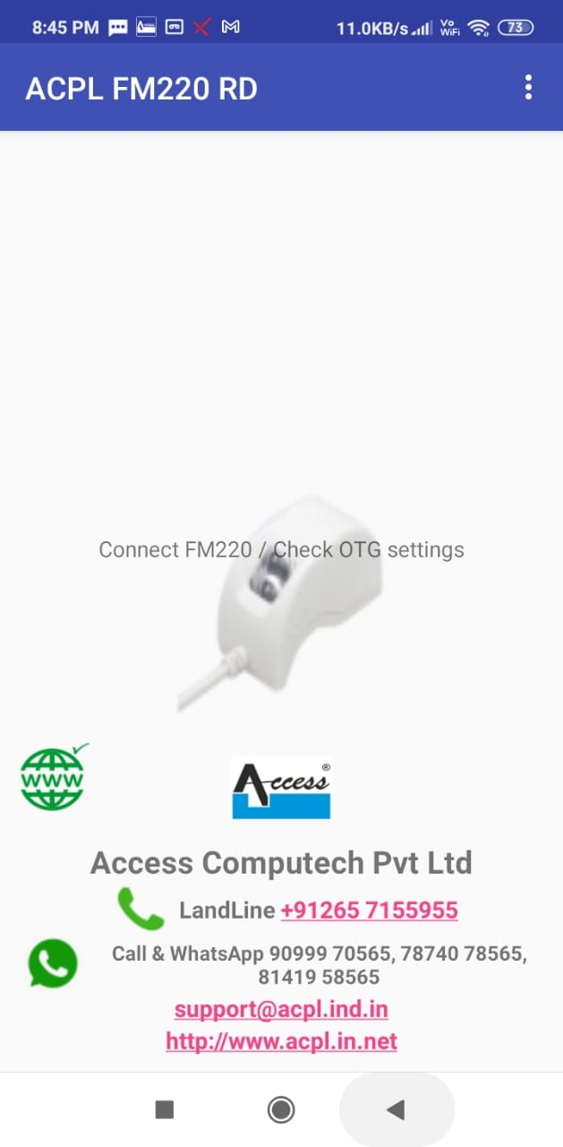
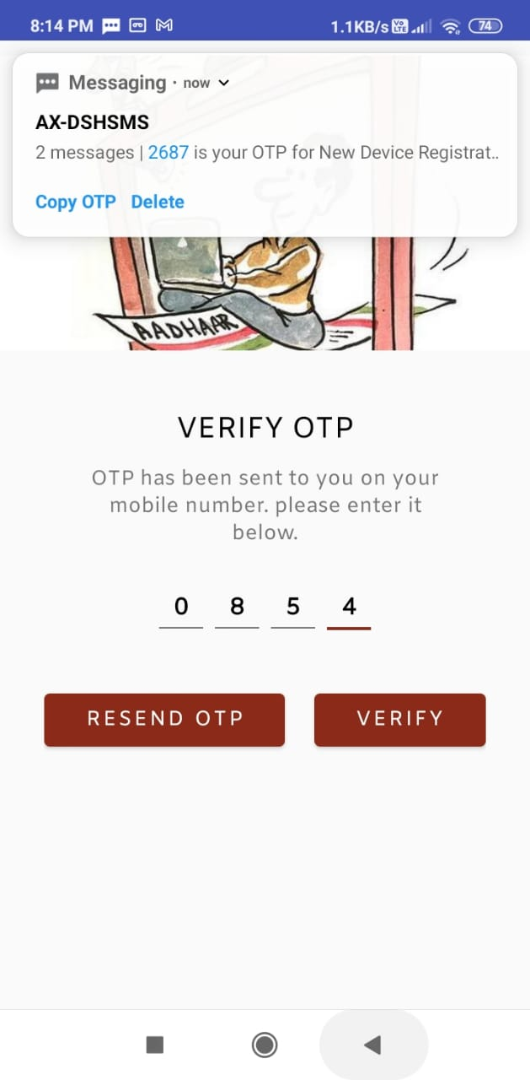
AEPS on Smartphone (Mobile)
1. Open Dash Board Screen, GO TO AEPS.
2. Click on Devise Register…..You will get SMS of OTP
3. Download the Your Finger Print Devise RD Service from Google Play Store –
Mantra / Startek RD Services from Google Play Store.
4. Enter OTP
www.orbitzfin.com

Slide 17
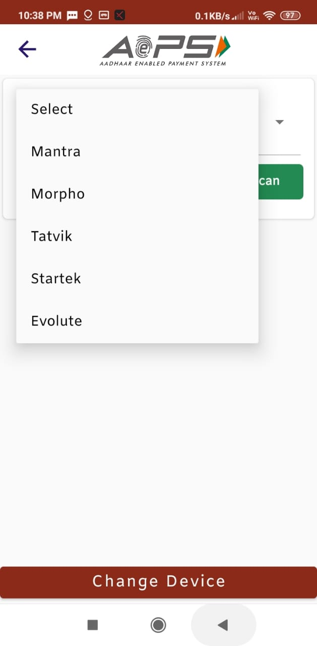
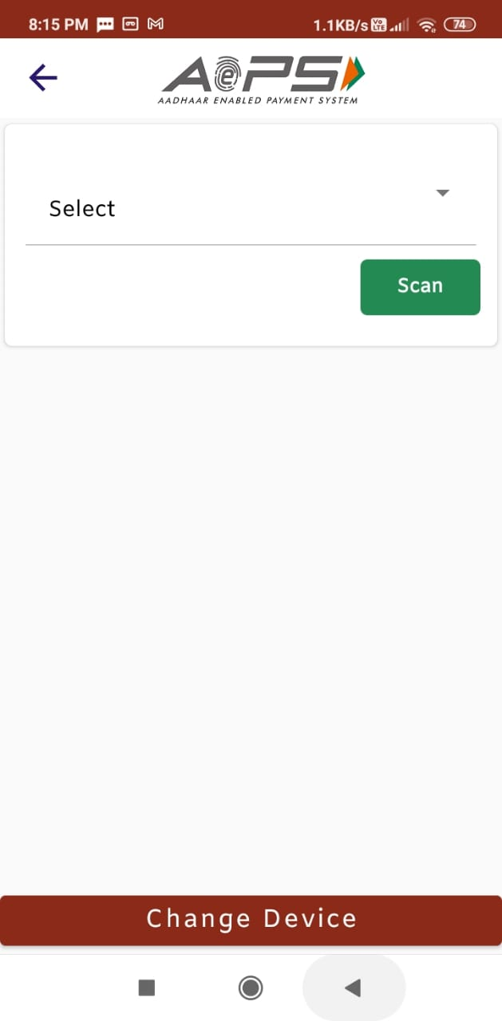
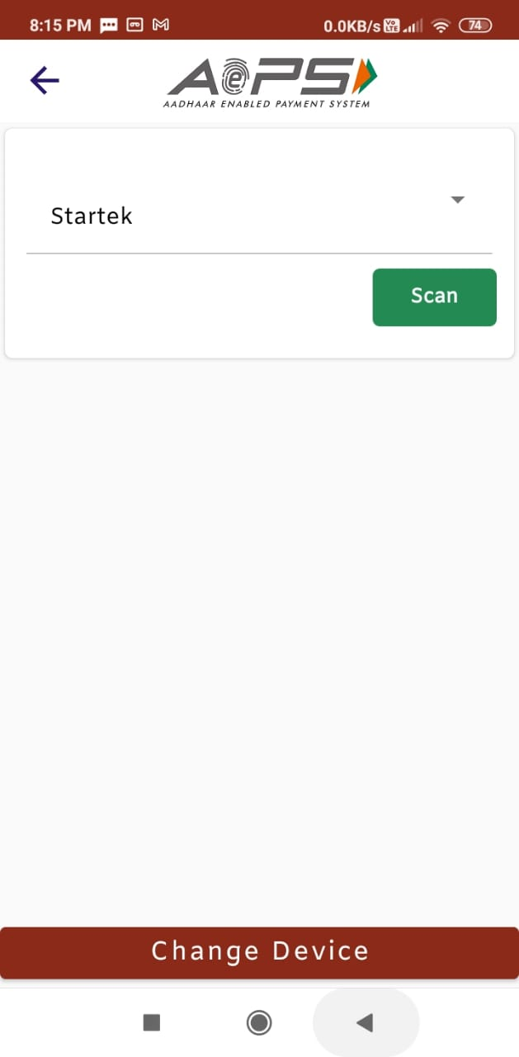
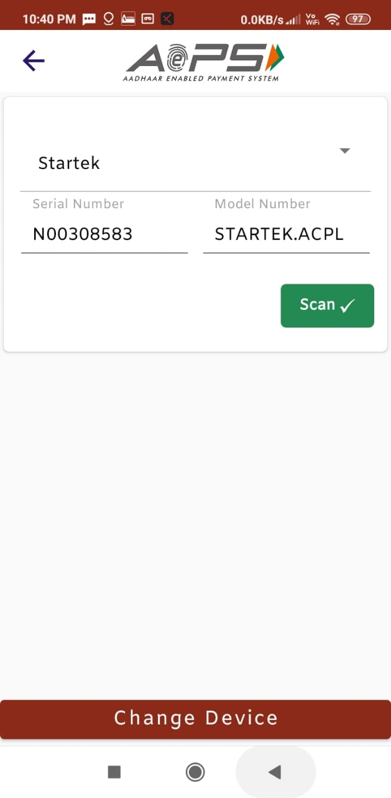
AePS ON SMARTPHONE (MOBILE)
1. On the Screen appeared, Select your Device. Press SCAN.
2. You will get the Serial Number of your FPS Device.
3. Press Change Device. Your Device will be registered.
www.orbitzfin.com

Slide 18
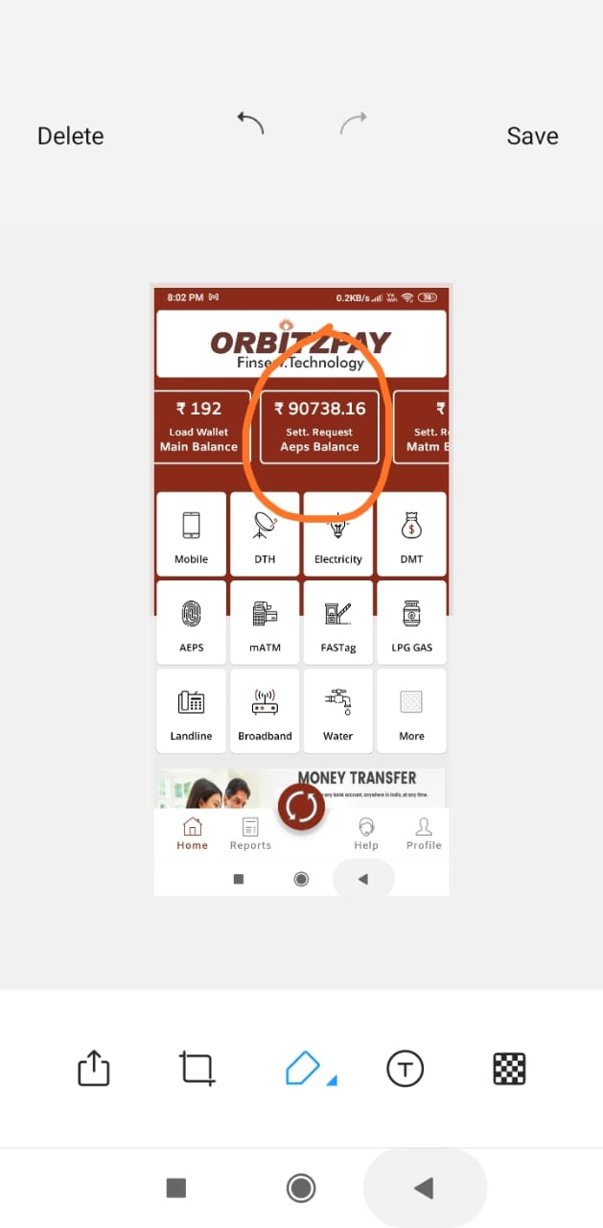
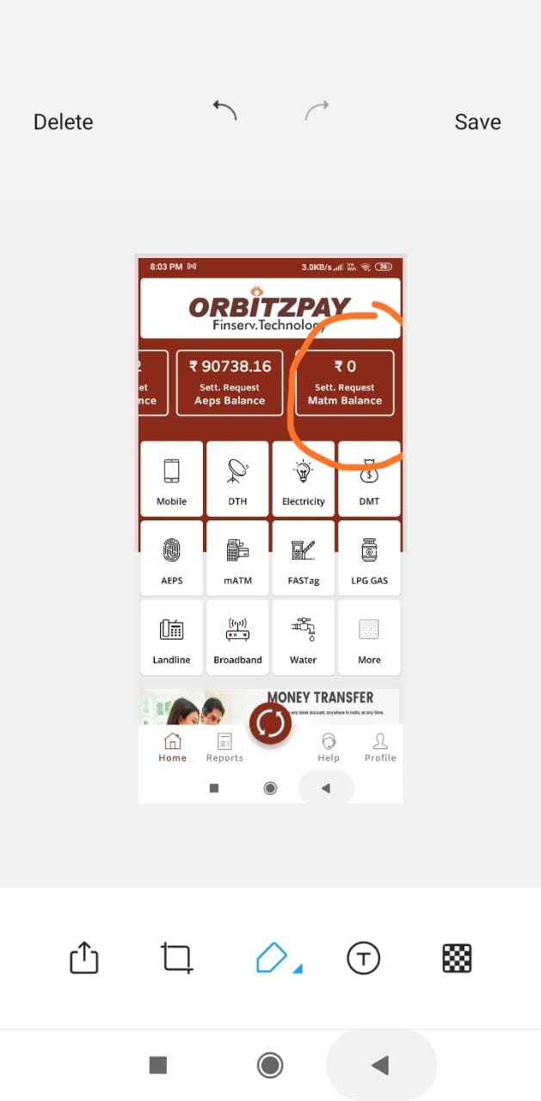
AePS ON SMARTPHONE (MOBILE)
1. Open the Dash Board.
2. The middle one is your Main Wallet.
3. The left side Wallet is AEPS Wallet.
4. Right side Wallet is mATM Wallet.
www.orbitzfin.com

Slide 19
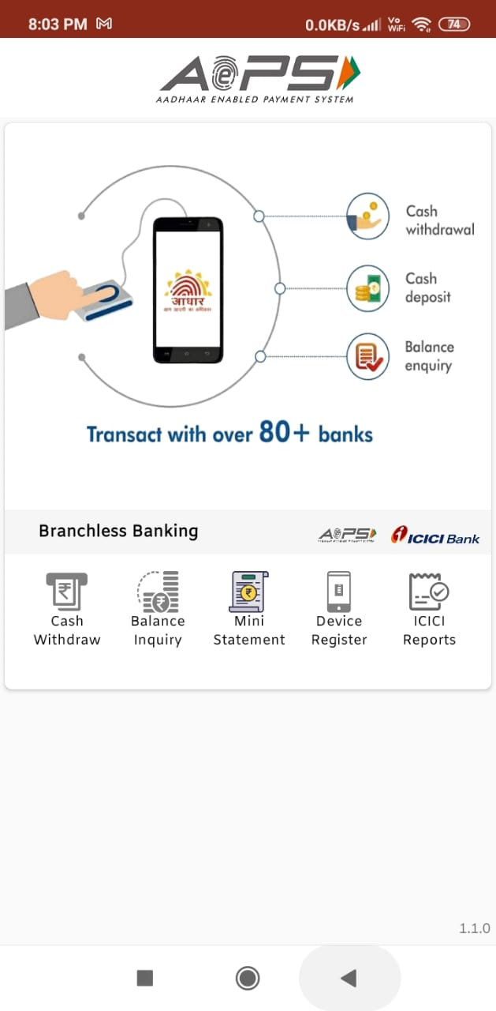
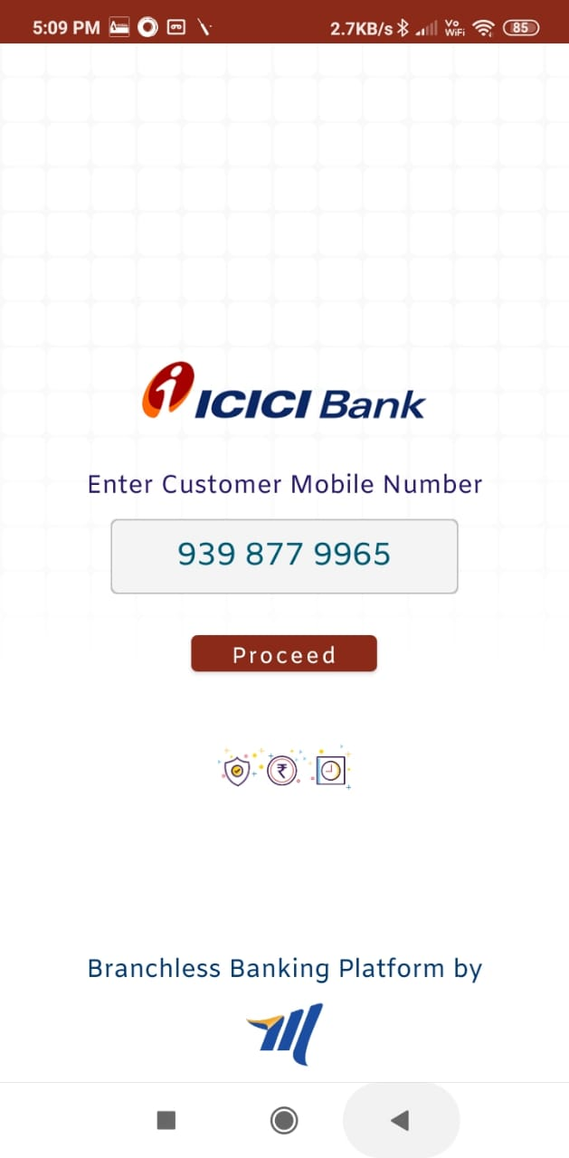
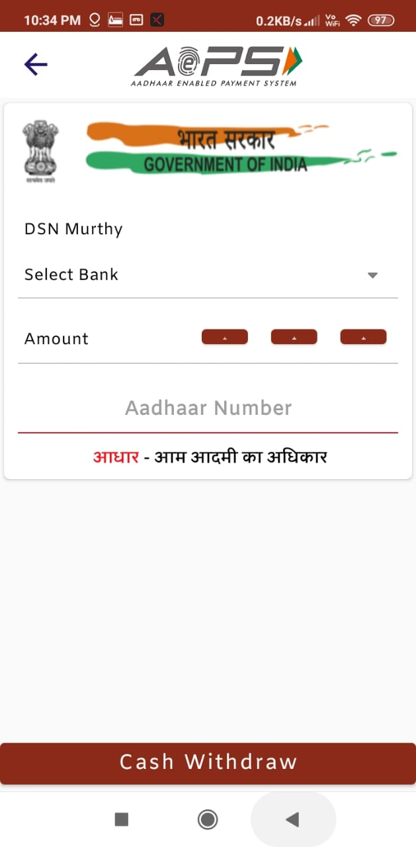
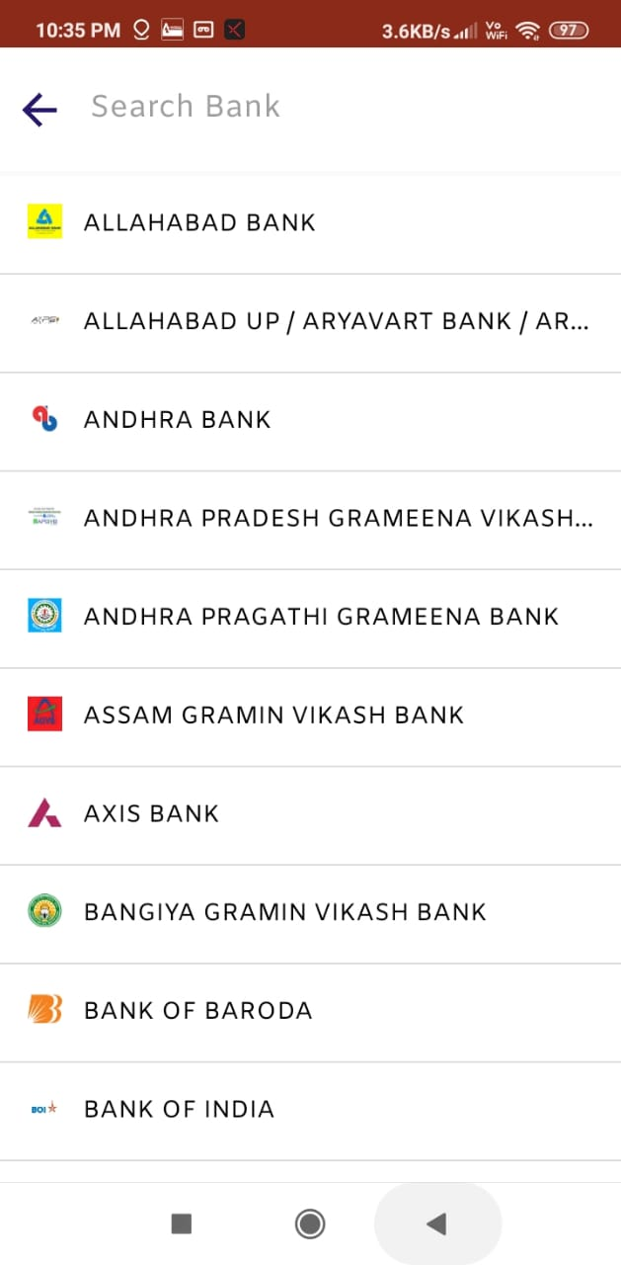
CASH WITHDRAWAL
For Cashwithdrawal, Go to CASHWITHDRAWAL ICON.
Select Customer Mobile Number.
Enter Select Bank from the List.
Enter Amount & Aadhar Number, Press Cash Withdrawal at bottom.
www.orbitzfin.com

Slide 20
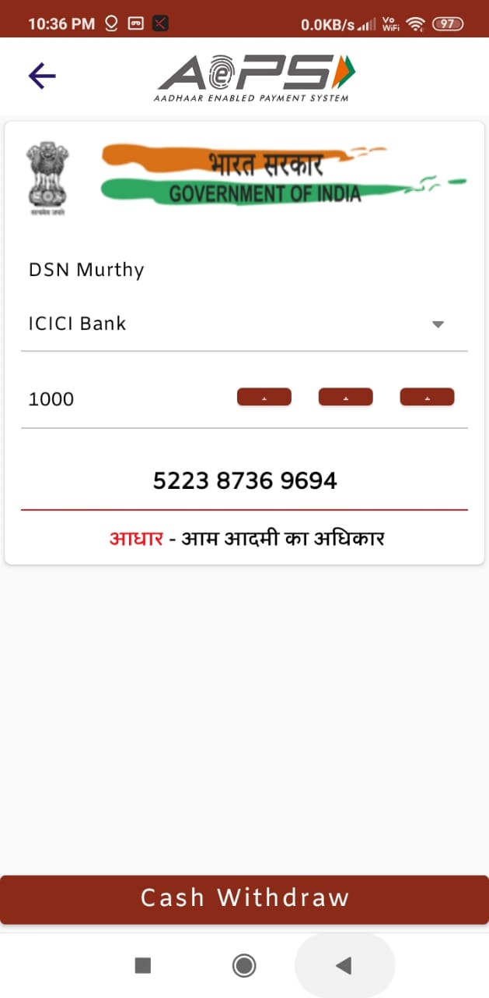
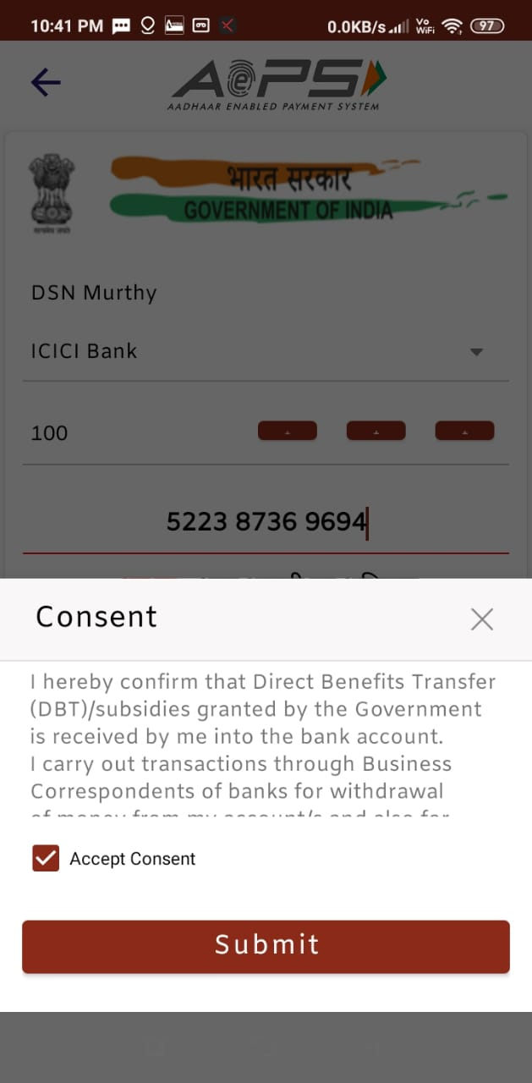
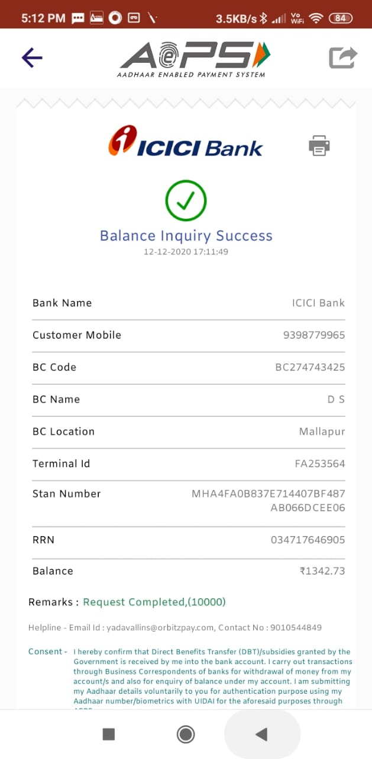
CASH WITHDRAWAL
Press Consent and Submit.
You will get the screen whether Cash withdrawal is Success OR Failed.
You can take a Print by pressing the Printer ICON.
Select Bank. Enter Amount and Aadhar Number of Customer.
You will get Consent Screen, and tick then Submit.
You will get message of successful withdrawal.
www.orbitzfin.com

Slide 21
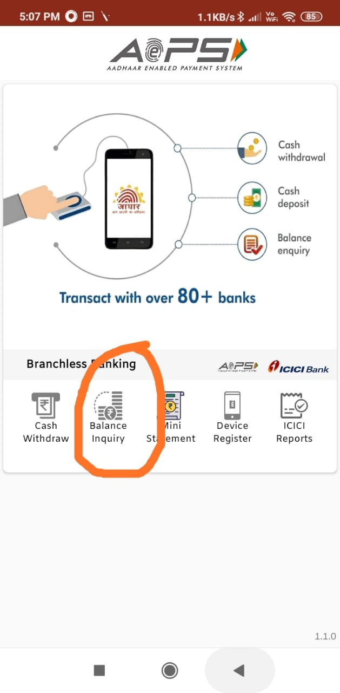
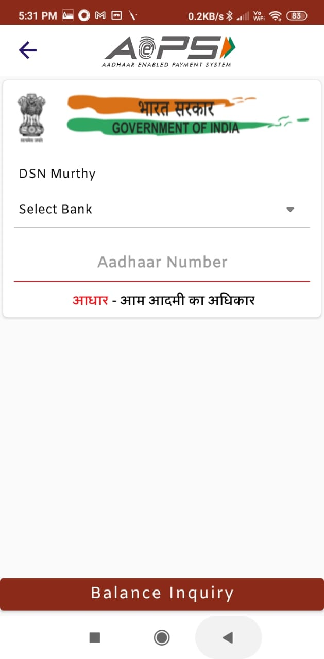
BALANCE ENQUIRY
For Balance Enquiry, ….Press Balance Enquiry Icon.
Enter Customer Mobile Number, Enter Aadhar Number.
You will get the Balance Enquiry.
www.orbitzfin.com

Slide 22
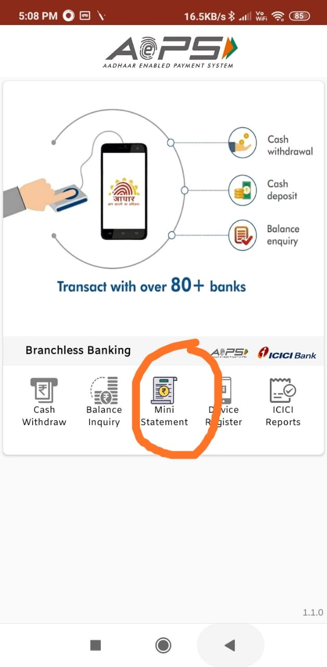
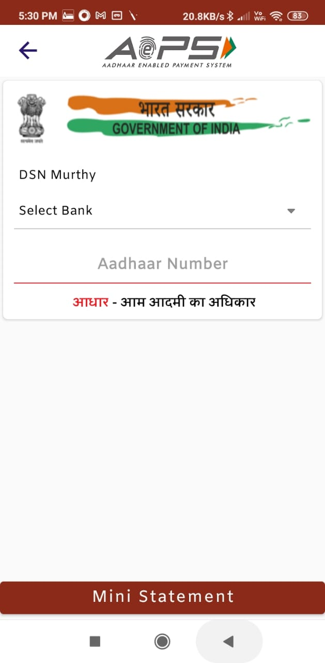
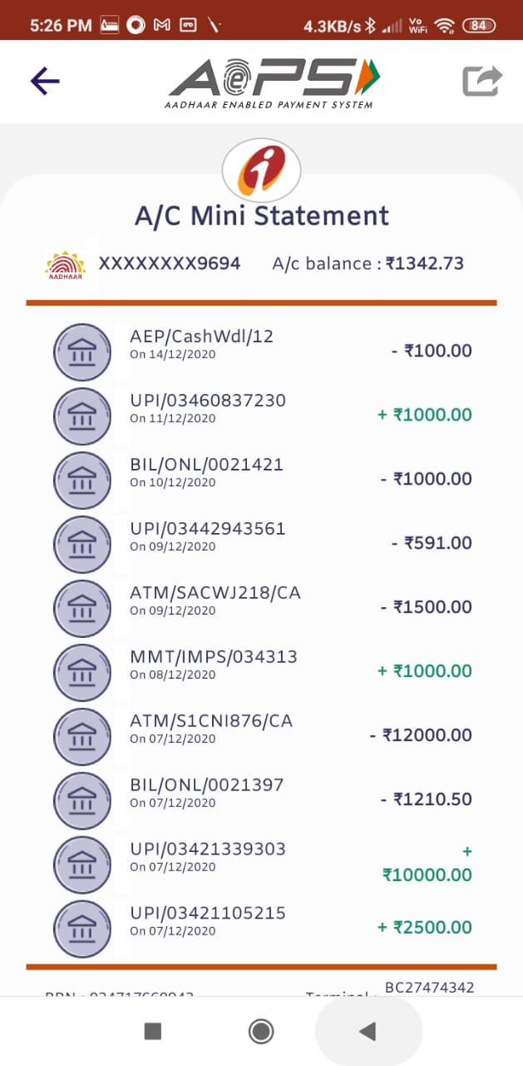
MINI STATEMENT
For MINI STATEMENT, ….Press Mini Statement Icon.
Enter Customer Mobile Number, Enter Aadhar Number.
You will get the Mini Statement.
www.orbitzfin.com

Slide 23
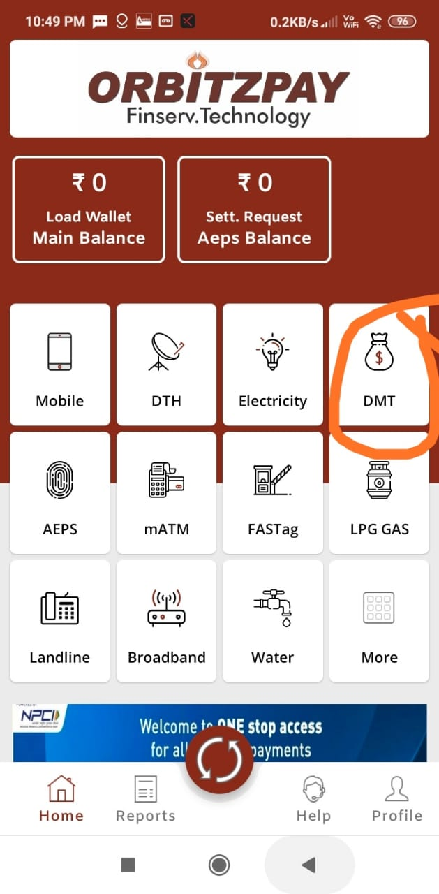
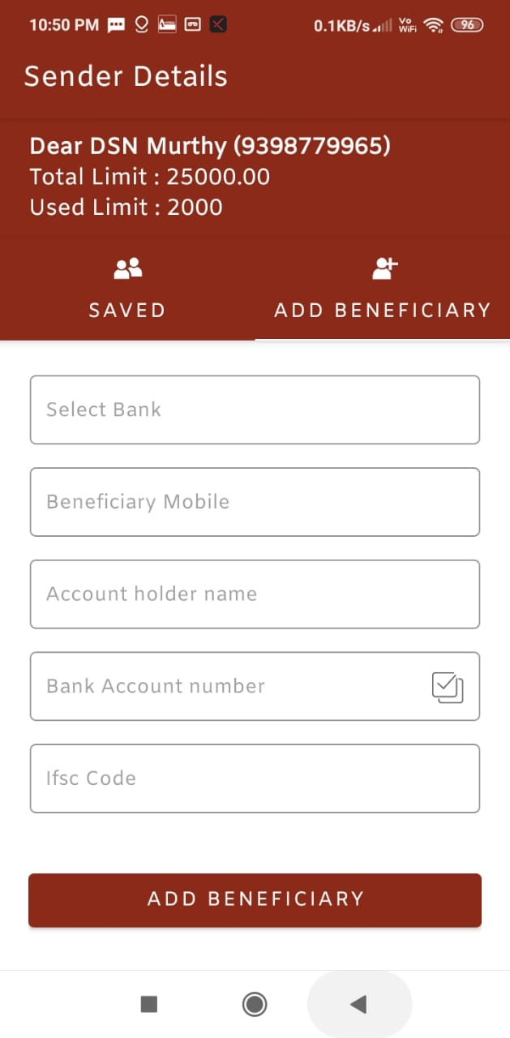
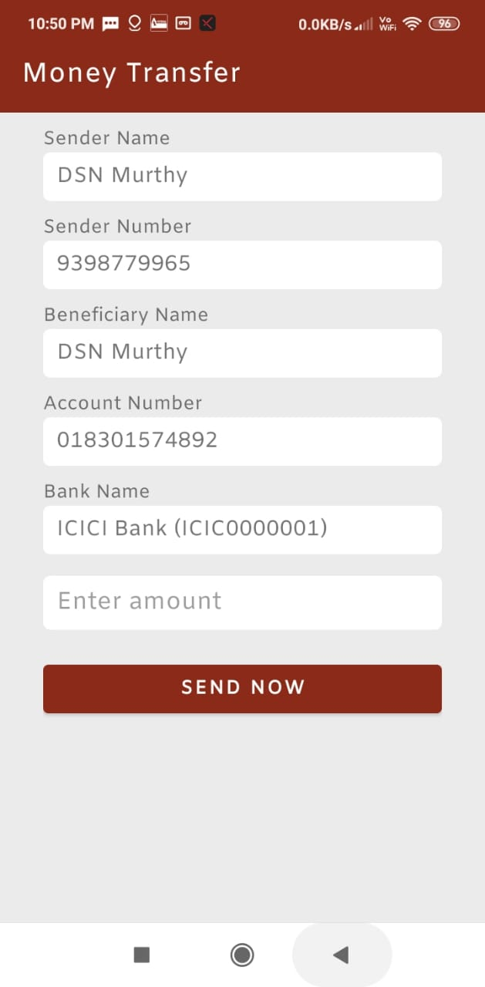
DIRECT MONEY TRANSFER (DMT)
Open Dash Board Screen.c
Go to DMT……Enter Mobile Correct Bank Account Number & IFSC Code.
Details as per Pic show…..Details of the Beneficiary.
www.orbitzfin.com

Slide 24
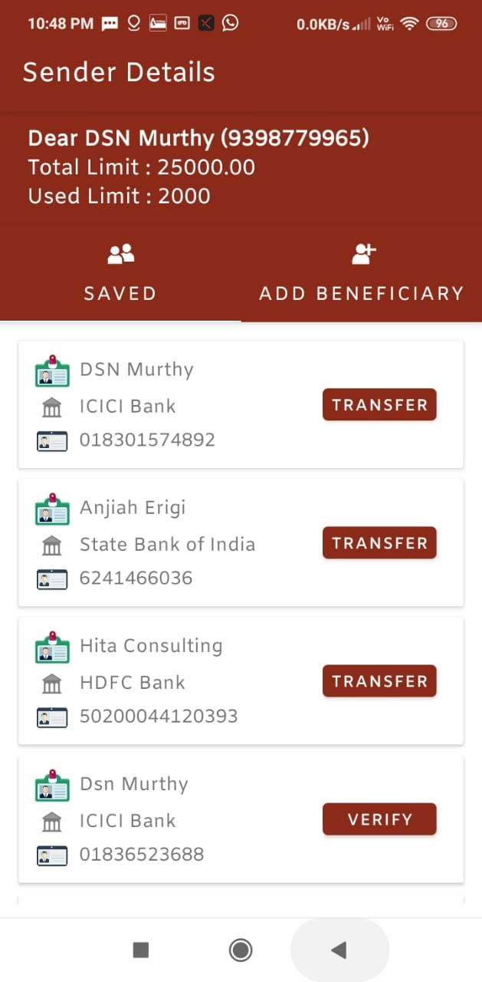
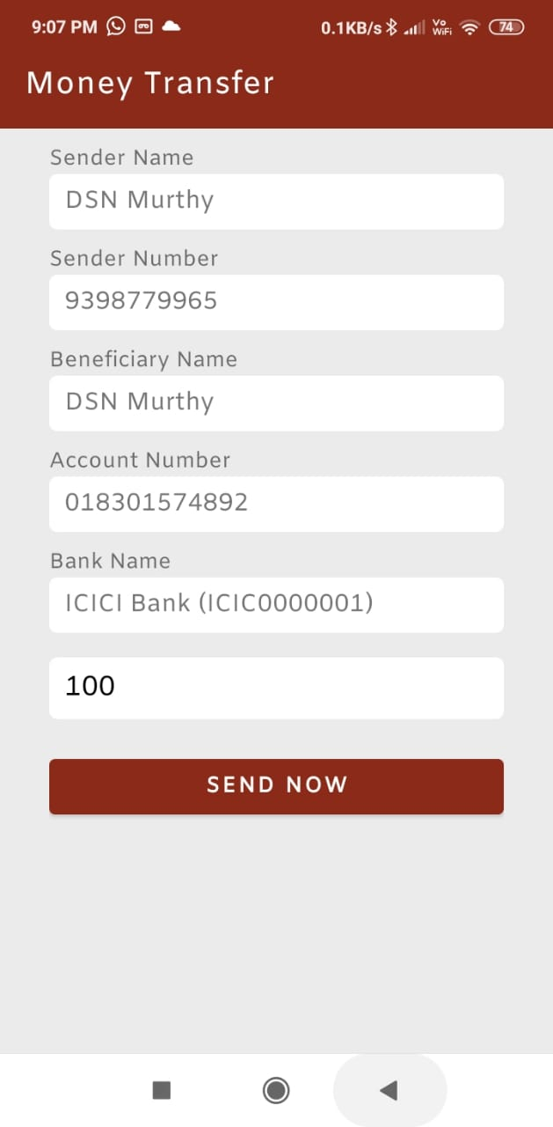
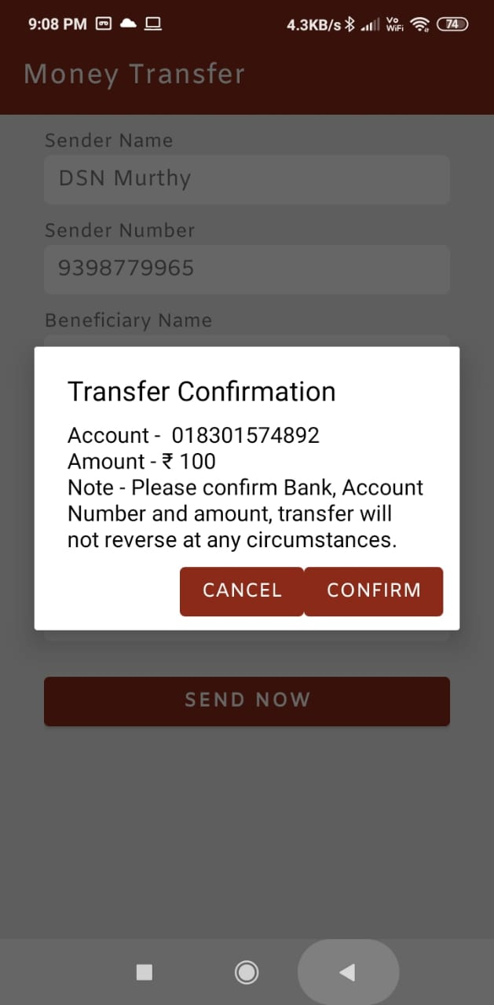
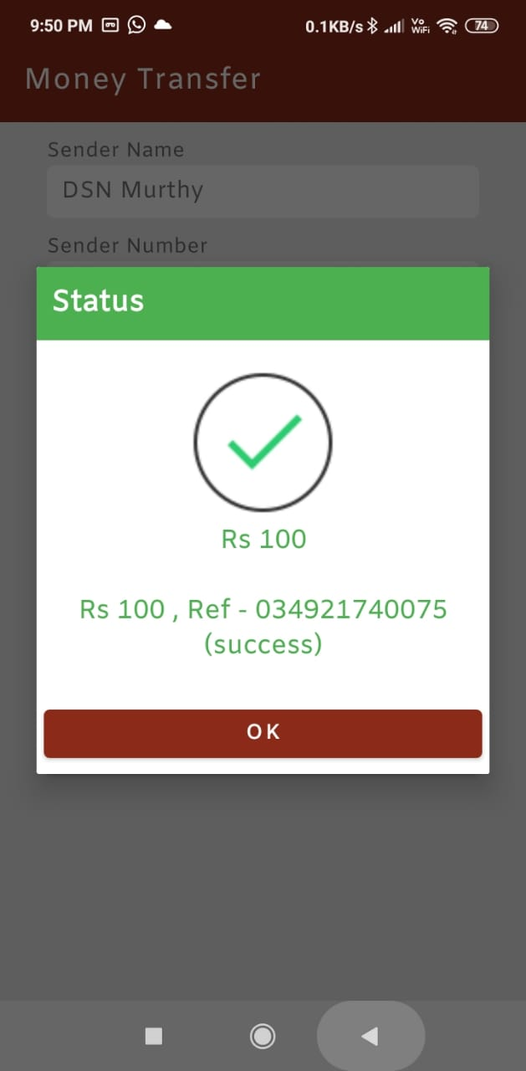
Direct Money Transfer (DMT)
Once the details of Beneficiary is entered it will be stored.
Select amount and press sent now.
Confirm transfer.
DMT will be successful.
www.orbitzfin.com

Slide 25
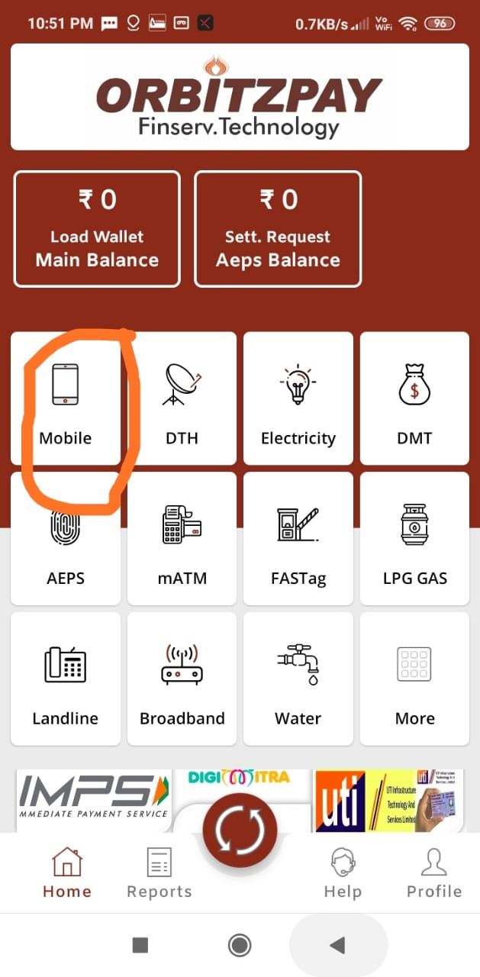
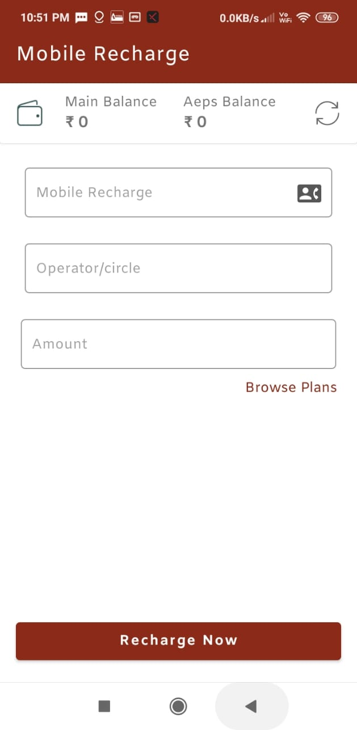
Mobile Recharge
From Dashboard, select Mobile Recharge.
Ensure there is sufficient amount in Main Wallet.
Select Mobile Number, Operator & Amount
Your Mobile Number will be recharged.
www.orbitzfin.com

Slide 26
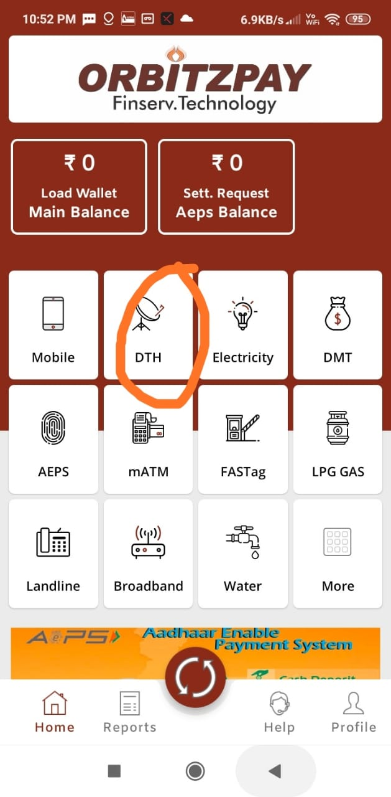
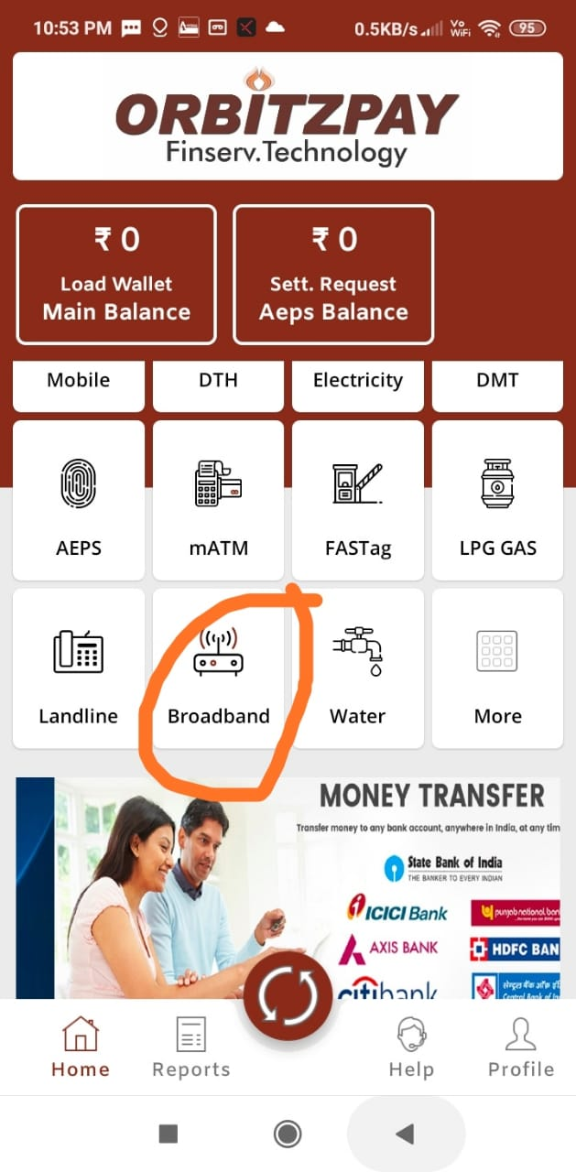
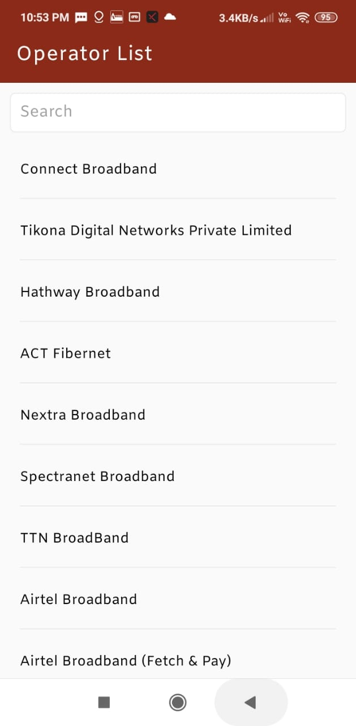
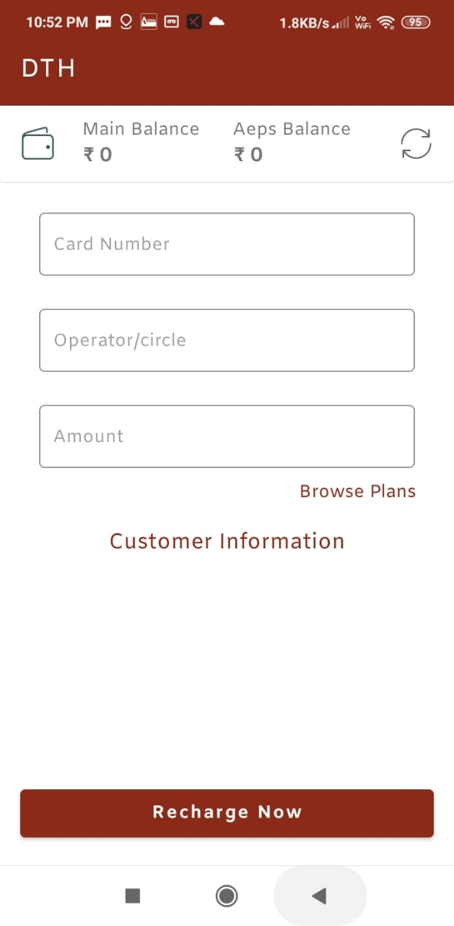
DTH / BROADBAND Recharge
From Dashboard, select DTH Recharge.
Ensure there is sufficient amount in Main Wallet.
Select Number, Service Provider & Amount
Your will be recharged.
www.orbitzfin.com

Slide 27
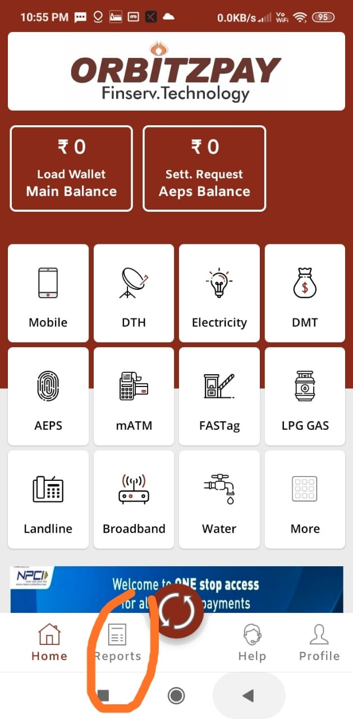
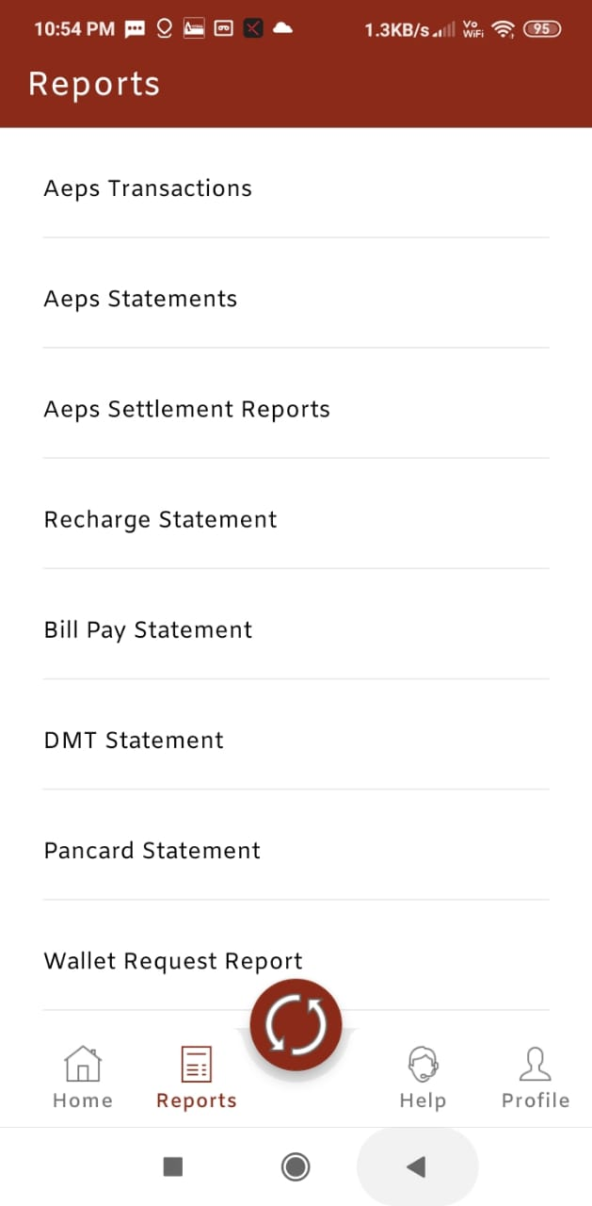
REPORTS
For Generating Reports, Go To Reports Icon on Dash Board Screen.
Select the Type of Report – you want to generate.
You will get the report of your choice which you can print.
www.orbitzfin.com

Slide 28
REPORTS
For Generating Reports, Go To Reports Icon on Dash Board Screen.
Select the Type of Report – you want to generate.
You will get the report of your choice which you can print.
www.orbitzfin.com

Slide 29
CHANGING PASSWORD
Go to Profile in the Dash board.
Go to Change Password option.
Enter Old Password and type the Password you want to enter.
Confirm or retype your New Password again – your New Password will be set.
www.orbitzfin.com

Slide 30
LOG OUT FROM APP
Go to Profile
Press Log Out Icon and you will be logged out.
www.orbitzfin.com

Slide 31
OrbitzPay…… Launches An Ideal Solution …..
GUARANTEED INCOME PLAN
For everyone
www.orbitzfin.com

Slide 32
THANK YOU
www.orbitzfin.com

